Slide 1
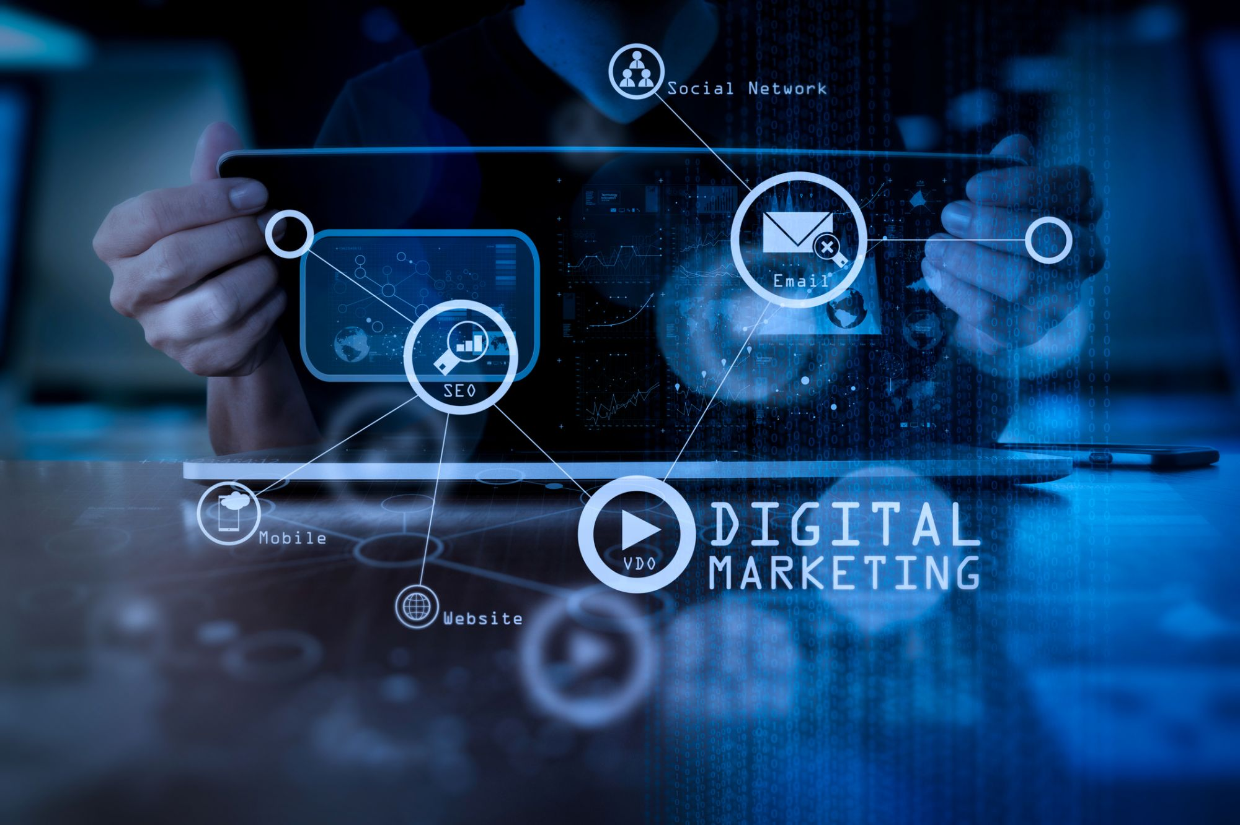

Slide 2
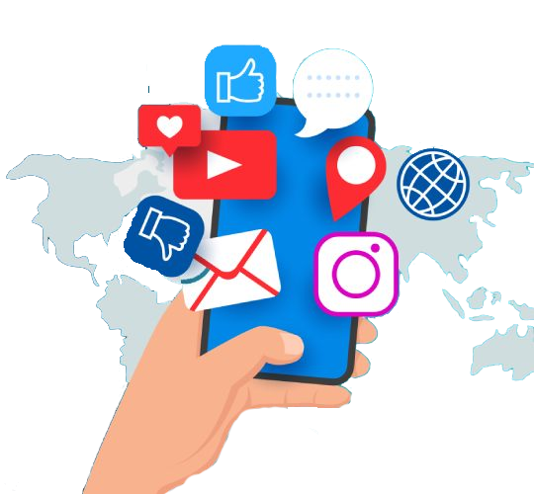
Basics of Social Media Strategy
vs
Organic Content
Paid Content

Slide 3
Overview of Social Media Strategy
Definition
A plan for using social media to achieve specific business goals
Importance
Aligns marketing efforts with business objectives
Enhances brand awareness, engagement, and conversion rates

Slide 4
Organic Content Marketing
What is Organic Content?
Content shared on social media without paid promotion
Examples
Posts, stories, comments, shares, and interactions
Benefits
Cost-effective
Builds authentic relationships with the audience
Increases brand loyalty and trust

Slide 5
Creating Organic Content
Key Elements
Quality
High-quality, engaging, and relevant content
Frequency
Regular posting to maintain visibility and engagement
Engagement
Actively responding to comments and messages
Types of Organic Content
Informative articles, behind-the-scenes posts, user-generated content, and polls

Slide 6
Challenges of Organic Content
Challenges
Slower growth compared to paid methods
Algorithm changes affecting visibility
Requires ongoing effort and creativity
Strategies to Overcome Challenges
Analyze performance metrics and adapt strategies
Utilize trending topics and hashtags for increased reach

Slide 7
Paid Content Marketing
What is Paid Content?
Content that is promoted through paid advertising
Examples
Sponsored posts, ads on Facebook/Instagram, promoted tweets
Benefits
Immediate visibility and reach
Precise targeting options (demographics, interests)
Measurable results and ROI

Slide 8
Creating Effective Paid Content
Key Elements
Targeting
Define your audience for ads effectively
Creativity
Engaging visuals and compelling copy to attract attention
Call-to-Action (CTA)
Clear CTAs to guide users towards desired actions (e.g., sign-up, purchase)
Types of Paid Ads
Image ads, video ads, carousel ads, and story ads

Slide 9
Challenges of Paid Content
Challenges
Costs can accumulate quickly
Need for ongoing testing and optimization
Potential for ad fatigue among audiences
Strategies to Overcome Challenges
Regularly refresh ad content
Monitor and adjust targeting based on performance data

Slide 10
Integrating Organic and Paid Strategies
Balancing Both Approaches
Use organic content to build relationships and community
Utilize paid content to boost visibility and drive traffic to important campaigns
Cross-Promotion
Promote organic posts through paid ads to increase reach
Encourage followers to engage with both organic and paid content

Slide 11
Measuring Success of Your Strategy
Key Metrics
Organic
Engagement rates, followers gained, and shares
Paid
Click-through rates (CTR), conversion rates, and return on ad spend (ROAS)
Tools for Analytics
Utilize platform analytics (Facebook Insights, Instagram Insights) and Google Analytics

Slide 12
Discussion Questions
What experiences have you had with organic vs. paid content on social media?
(Invite participants to share insights or challenges)
Which strategy do you believe is more effective for your goals and why?
(Encourage discussion on the balance between the two strategies)

Slide 13
Next Steps and Final Project
Prepare for the Next Project
Create and optimize a Facebook or Instagram business page for a local business or personal brand

Slide 14


Slide 15


